Slide 1
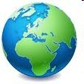
Globe
SK RAI

Slide 2

What is a globe ?
A globe :
Is a model of the earth
Gives an accurate picture of the earth’s surface
Shows the location of places on the a smaller scale

Slide 3
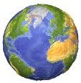
Earth’s surface
29 % of the earth’s surface is land.
Large land masses are called continents.
There are seven continents:
⎫Asia
⎫Africa
⎫North America
⎫South America
⎫Europe
⎫Australia
⎫Antarctica
71% of earth’s surface is covered by water.
Large water bodies are called oceans.
There are five oceans:
⎫Indian
⎫Pacific
⎫Atlantic
⎫Arctic
⎫Southern

Slide 4
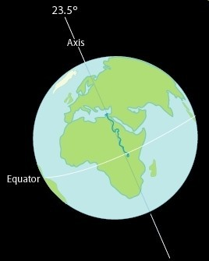
Features of the earth
The northernmost point of the earth is called the North Pole
The southernmost point of the earth is called the South Pole
An imaginary line running through the centre of the earth and joining the north and south pole is called the Axis of Rotation

Slide 5
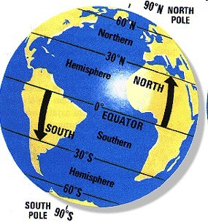
Features of the earth
An imaginary line running through the centre of the earth and dividing it into two equal parts is called the Equator.
The area north of the equator is called the Northern Hemisphere
The area south of the equator is called the Southern Hemisphere

Slide 6
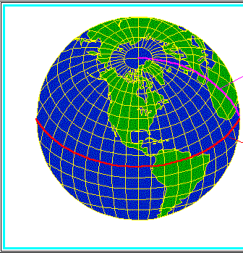
Longitudes and Latitudes
ν Imaginary lines run from the North Pole to the South Pole. These are called Longitudes.
νImaginary lines run parallel to the equator and are called Latitudes.

Slide 7
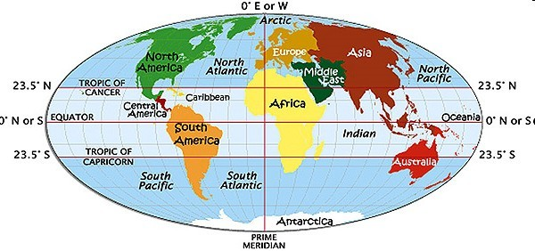
Important Latitudes
Arctic Circle at 66.5 degree north
Tropic of Cancer at 23.5 degrees north
ν Equator at 0 degree
Tropic of Capricorn at
23.5 degrees south
ν Antarctic Circle at 66.5 degree south

Slide 8
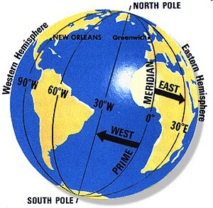
Longitudes
νImaginary lines run from the North Pole to the South Pole. These are called Longitudes or Meridians
νThe imaginary line that divides the earth into two equal halves- East and the West is called the Prime Meridian
νThe prime meridian passes through Greenwich and is called the Greenwich Meridian

Slide 9
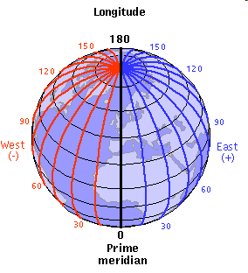
Rotation
The earth spins on its axis from west to east causing day and night.

Slide 10
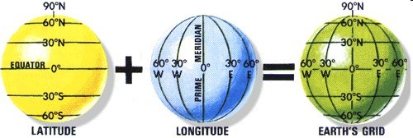
Earth Grid
νThe latitudes and the longitudes form a grid or a network on the earth’s surface called the earth grid

Slide 11
Earth Grid
ν Locating places with
the help of the earth grid:

Slide 12
Locating places using the grid.
Delhi is located at 28.38 N and 77.12 E.
28.38 N means 28.38 degrees latitude, north to the equator, and
21.42 E means 21.42 degrees longitude, east to the prime meridian.
Locate the latitude and the longitude on the margins of the map, and draw line extending from these points.
The point where these two lines meet on the grid gives us the location of Delhi.

Slide 13
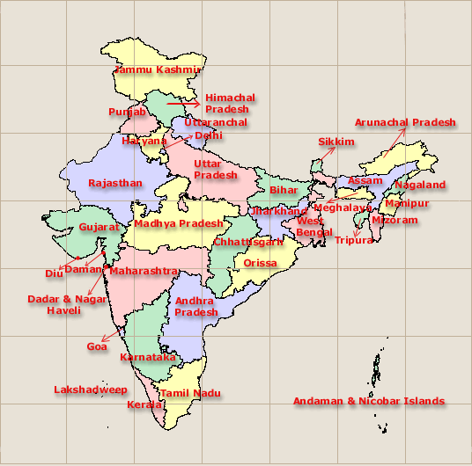




Delhi –located at
28.38 N and 77.12 E
77.12 E
28.38 N

Slide 14
Questions
Fill in the blanks.
The earth is in shape.
Imaginary lines that run parallel to the equator are called .
A small model of the earth is called the
.
A network between the latitudes and the longitudes is called

